Slide 1
Wine data analysis author: Akanchha bagla Revision number: 1.0 last date of revision: May 30, 2022
wireframe

Slide 2
TABLE OF CONTENTS
Document Version Control
Introduction
Points Distribution
Price Distribution
Price Vs. Points
Country
Taster
Variety
Winery
Description

Slide 3
DOCUMENT VERSION CONTROL
Date Issued | Version | Description | Author
May 30, 2022 | 1.0 | Distribution across Attributes | Akanchha Bagla
REVIEW
Date Issued | Version | Reviewer | Comments
APPROVAL
Date Issued | Version | Approved By | Comments

Slide 4
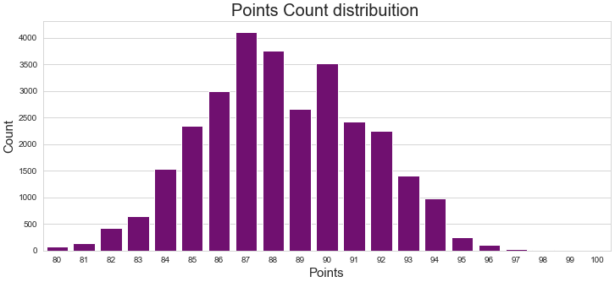
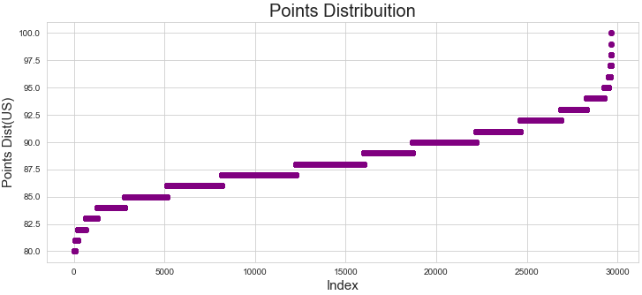
1. Points Distribution
How are points distributed?
If the range is between 80-84 points it is “Good” wine.
If the range is between 85-89 points it is “ very Good” wine.
If the range is between 90-94 points it is “Outstanding” wine.
If the range is above 95 it is a “Classic” wine.
Classic wines are a rare find.

Slide 5
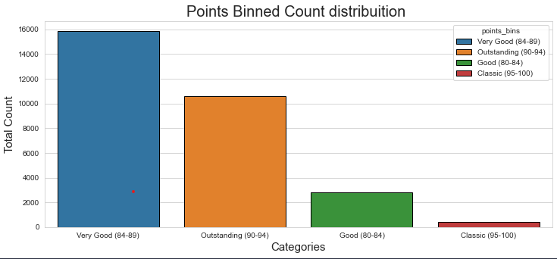
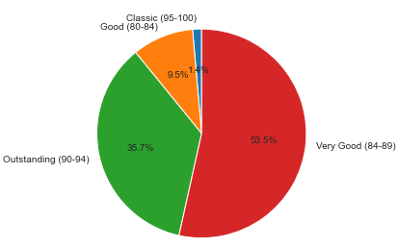
1. Points Distribution
The data consists of 53.5 % of Very Good wines and only 1.4% of Classic wine selection, depending on the points allotted to each wine.
Majority of the wines are in the range of 85-90.

Slide 6
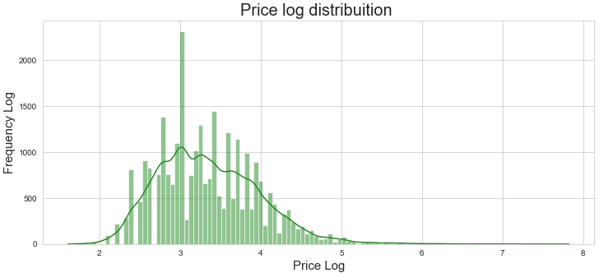
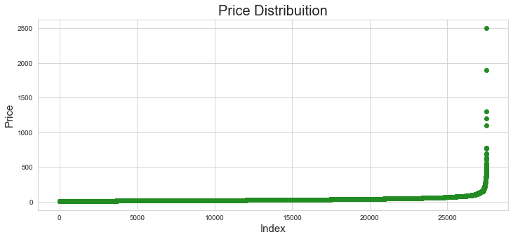
2. Price Distribution
High priced wines are very few, whereas most of the wines range under $100, as we see a steep rise in price distribution chart.
From the Price Log Distribution, we can conclude that majority of wines fall under the log between 2.5-4.
For reference price log range of 2-3 is $7 - $20 approximately and 3-4 is $21- $55 approximately.

Slide 7
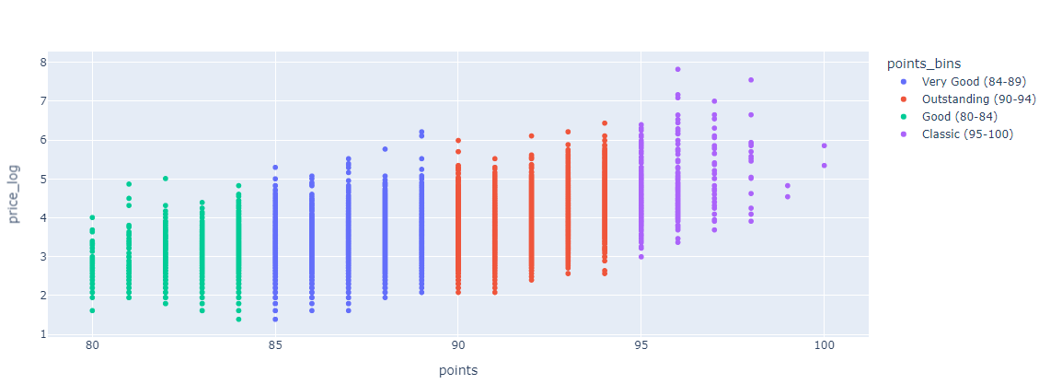
3. Price Vs. points
We see an upward trend in this distribution as the points increase the price also increases.

Slide 8
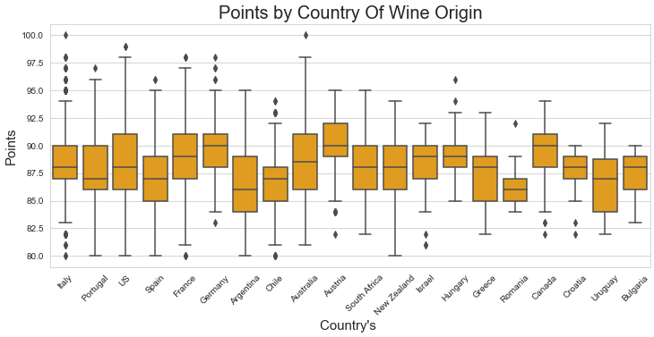
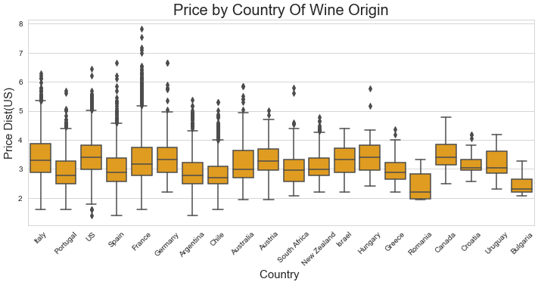
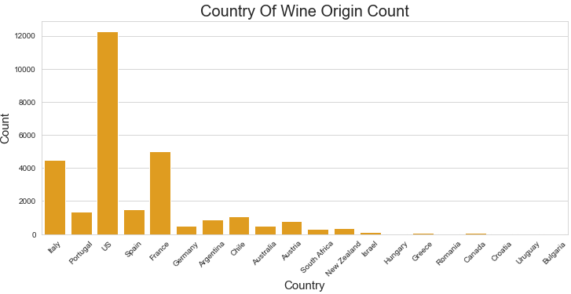
4. Country
Top 3 country’s price log distribution remains between 3-4, with outliers reaching up to 8.
Their wines are majorly scored between 85-92 points with outliers ranging as low as 80 points and as high as 100 points. Which means they produce very good to outstanding quality of wines. Along with few classic wines.
US, France, Italy are the Top 3 wine producing Countries.

Slide 9
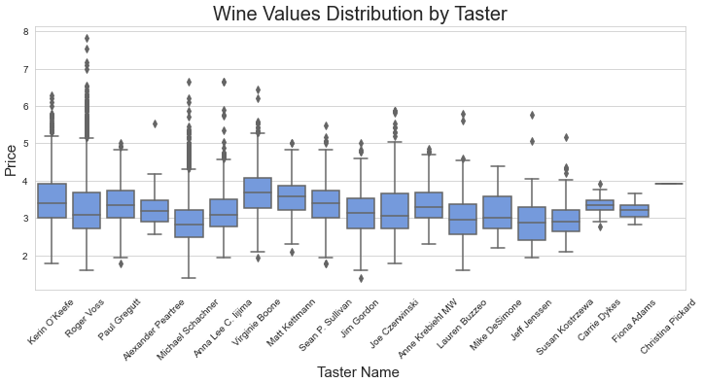
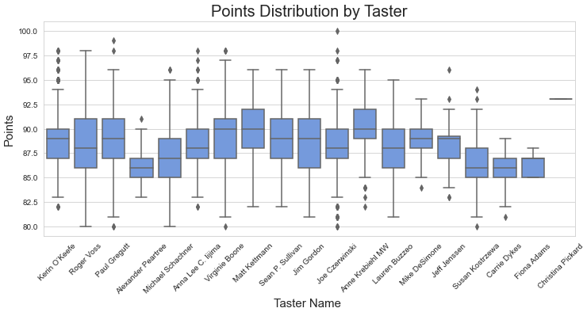
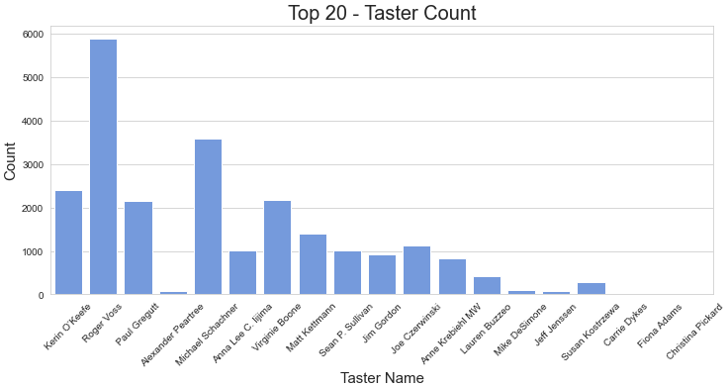
5. Taster
Points allotted by top taster are usually 85-92.Which means they produce very good to outstanding quality of wines.
Price log from top tasters remain within the average range of 2.5-4.
Top 3 Tasters with most number of wine tastings are “Roger Voss”, “Michael Schachner” and “ Kerin O'Keefe”.

Slide 10
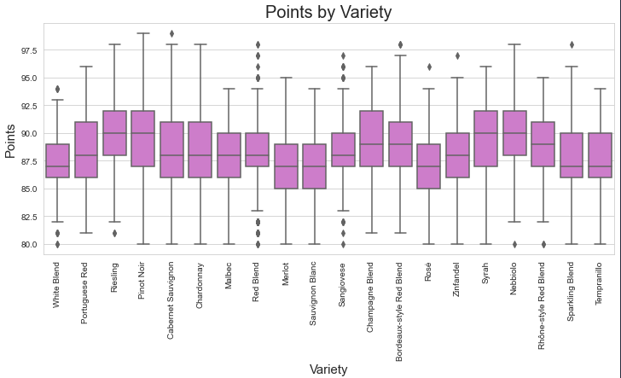
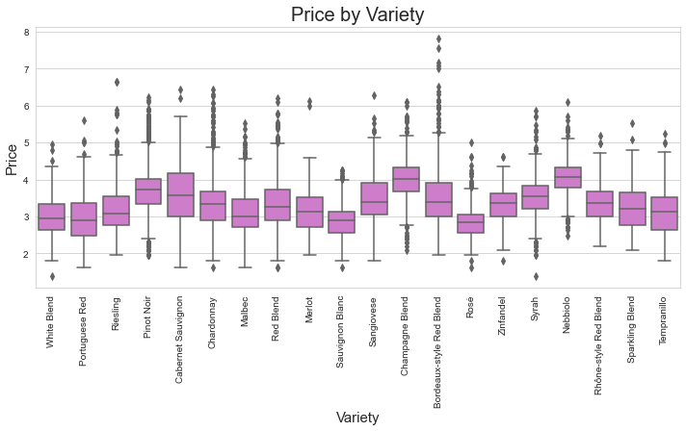
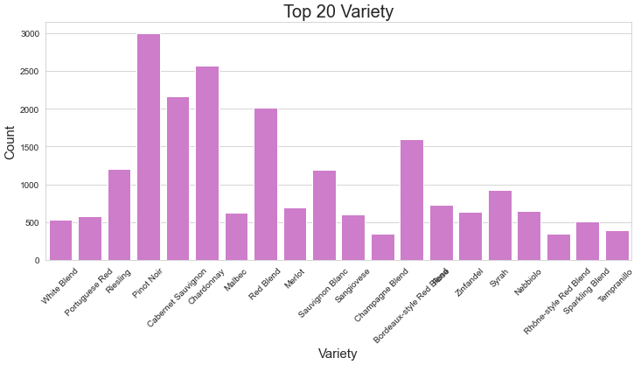
6. Variety
Average points of the top 3 varieties are between 86-92. Which means they produce very good to outstanding quality of wines.
The average price log of these wines are anywhere e between 2.5-4.5.
Top 3 Wine varieties are “Pinot Noir”, “ Chardonnay” and “Cabernet Sauvignon”

Slide 11
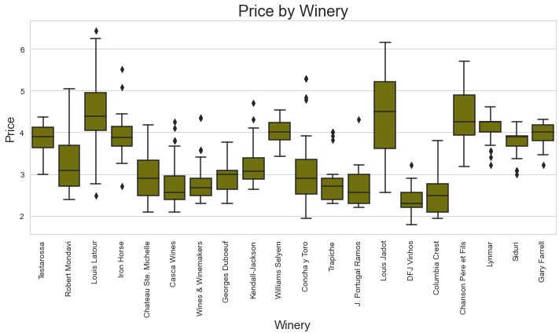
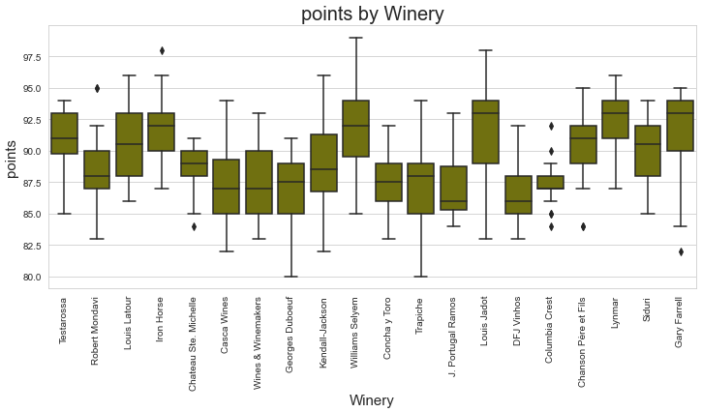
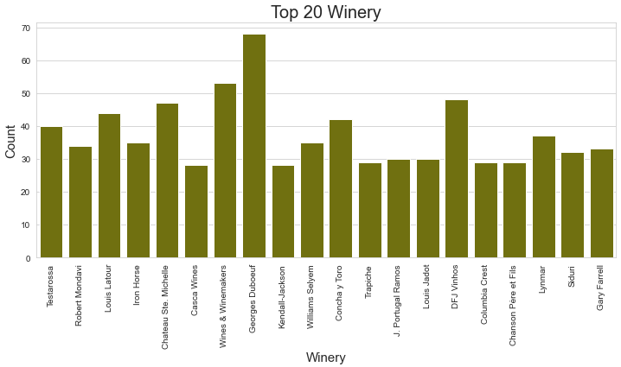
7. Winery
Top 3 wineries produce very good wines with of 85-90 points. They might not be the highest rated, but they are top producers.
Their price log is also average between 2.5 – 3.5. The most expensive wine comes from “Louis Latour”.
Top 3 wineries are “ Georges Duboeuf”, “Wines & Winemakers” and “DFJ Vinhos”.

Slide 12
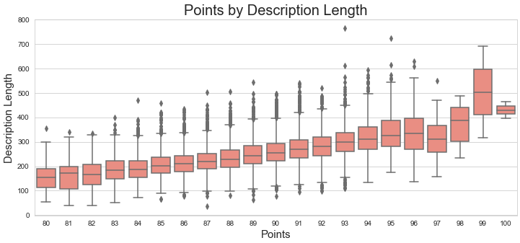
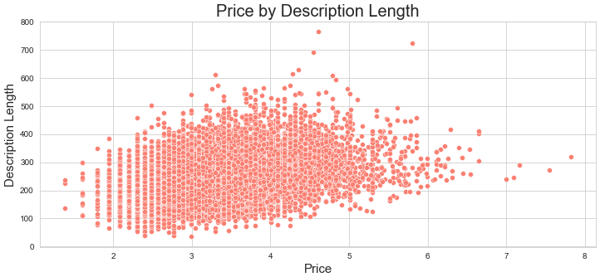
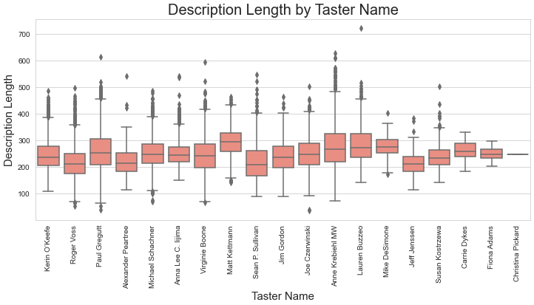
8. Description
We can see that as the description length increase there is growth in the points allotted to the wine.
We see a cluster of wines with price log between 2.5-5 with description length anywhere between 100-400 words.
Average words by all the tasters are between 150-350. Not much difference can be seen.

